Slide 1
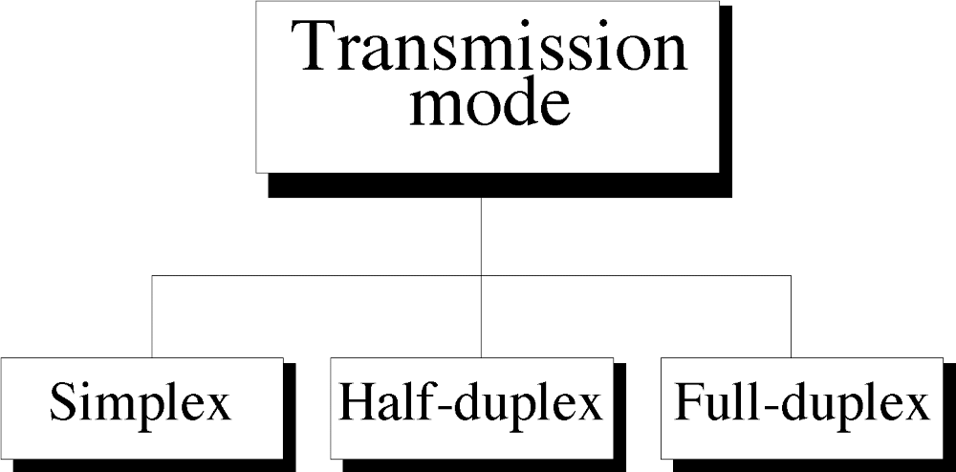
Figure 2-11
WCB/McGraw-Hill
© The McGraw-Hill Companies, Inc., 1998

Slide 2
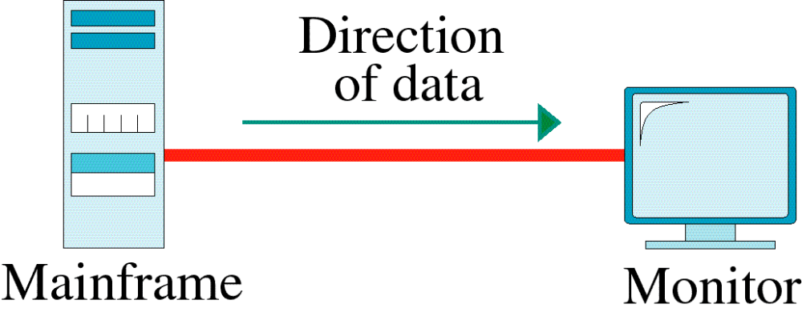
Figure 2-12
Simplex
WCB/McGraw-Hill
© The McGraw-Hill Companies, Inc., 1998

Slide 3
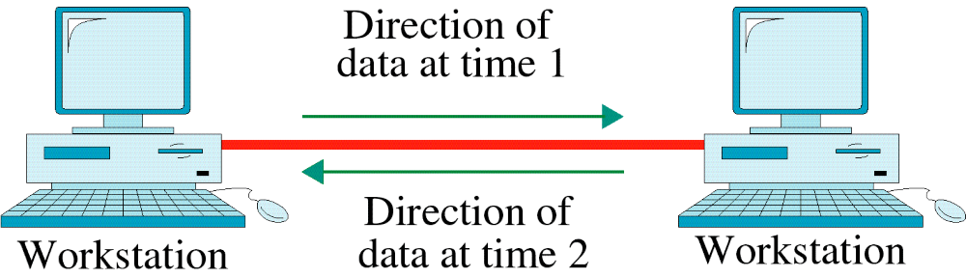
Figure 2-13
Half-Duplex
WCB/McGraw-Hill
© The McGraw-Hill Companies, Inc., 1998

Slide 4
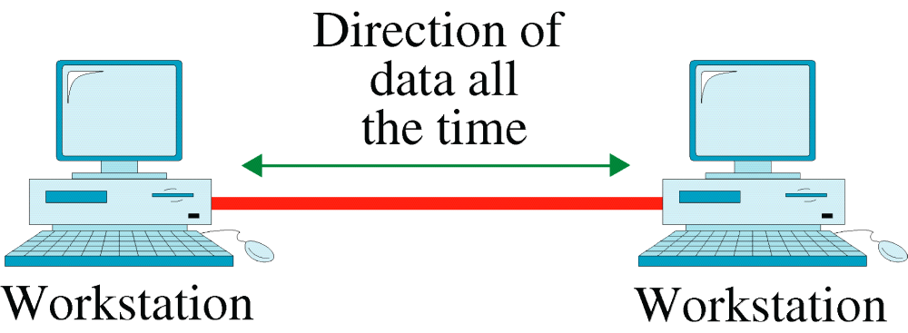
Figure 2-14
Full-Duplex
WCB/McGraw-Hill
© The McGraw-Hill Companies, Inc., 1998

Slide 5
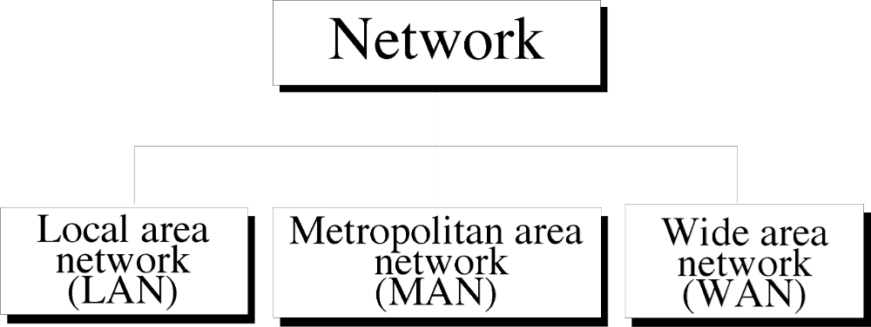
Figure 2-15
WCB/McGraw-Hill
© The McGraw-Hill Companies, Inc., 1998

Slide 6
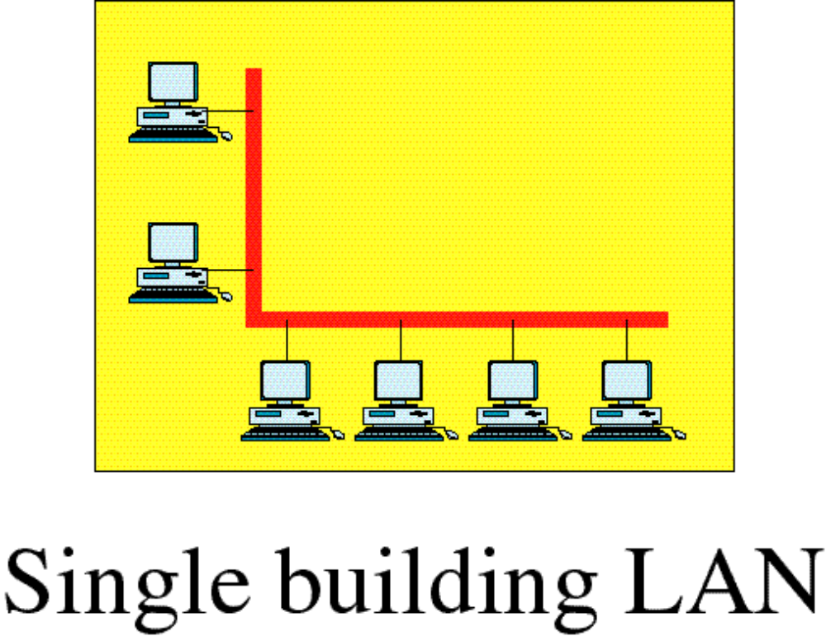
Figure 2-16
Local Area Network
WCB/McGraw-Hill
© The McGraw-Hill Companies, Inc., 1998

Slide 7
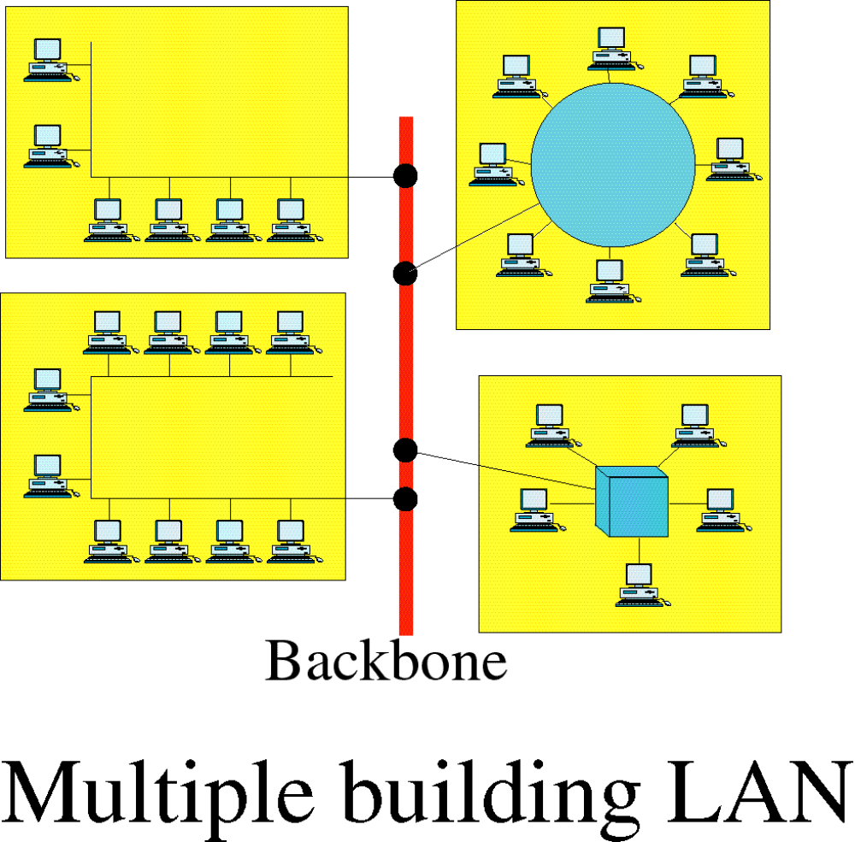
Figure 2-16-continued
Local Area Network
WCB/McGraw-Hill
© The McGraw-Hill Companies, Inc., 1998

Slide 8
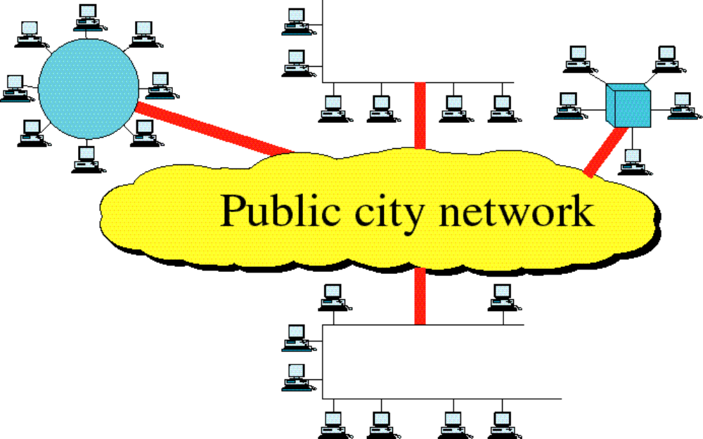
Figure 2-17
Metropolitan Area Network
WCB/McGraw-Hill
© The McGraw-Hill Companies, Inc., 1998

Slide 9
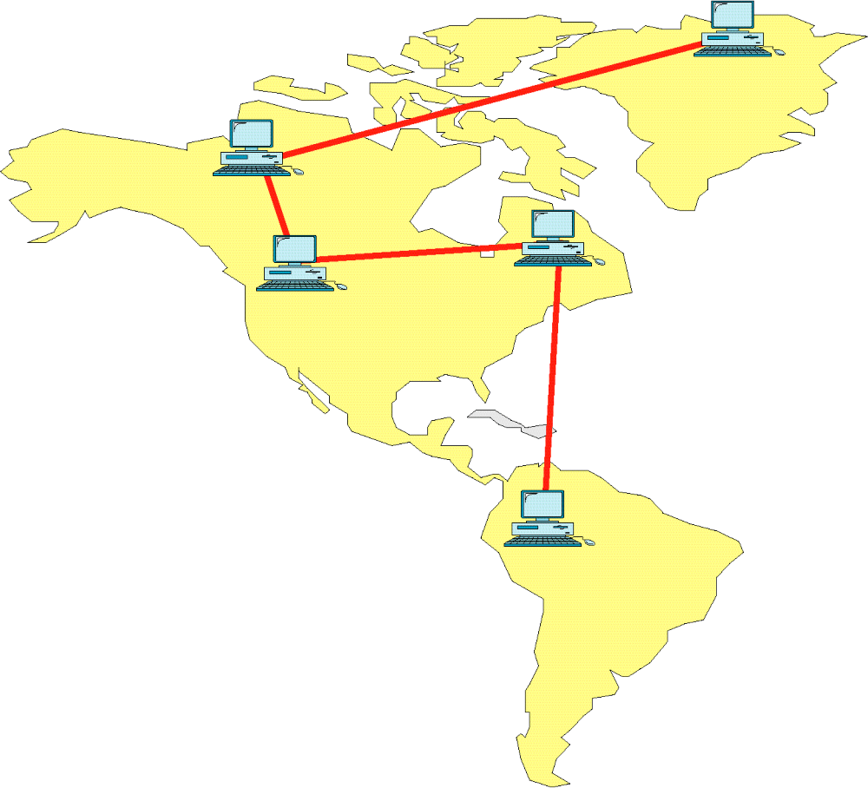
Figure 2-18
Wide Area Network
WCB/McGraw-Hill
© The McGraw-Hill Companies, Inc., 1998

Slide 10
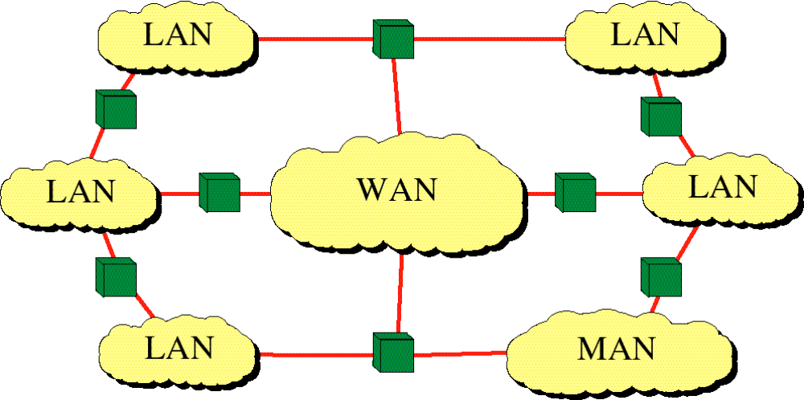
Figure 2-19
Internetwork
(Internet)
WCB/McGraw-Hill
© The McGraw-Hill Companies, Inc., 1998

